Slide 1
Janklyan Blood Bank
-Omkar Deshpande
-Kunal Chadha

Slide 2
Need Of Mobile App
Blood Banks keep track of a donor and all the data related to the donor on paper.However, this is not an efficient way of managing data.
Whenever there is an emergency, it is difficult to contact the donors manually to check if they are available. Also, if a blood bank is organising an event like a blood donation camp, etc. it becomes difficult to inform the donors.
Through this app we have solved all of these problems such as keeping track of a donor and his/her data, informing donors in case of emergencies or an event, etc.
This app lets donors interact amongst each other and hence aims to create a network of blood donors.

Slide 3
Key features :
- Paperless working of the blood bank
- Easy to get in touch with a blood donor
- Useful for keeping track of active donors
- Informs a donor about important events
- User responses for a particular event can be collected
- Users can interact with other blood donors (through posts) and hence build a network of blood donors

Slide 4
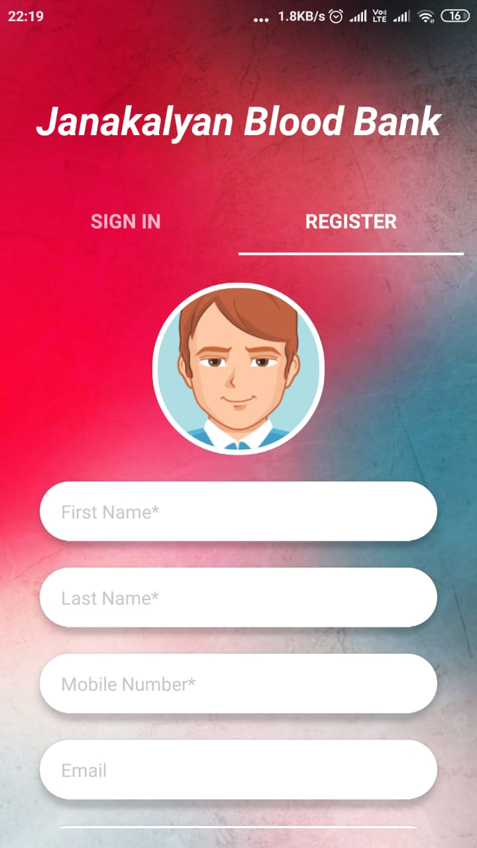
User registration
Any Blood Donor can register with the blood bank
by filling in this registration form

Slide 5
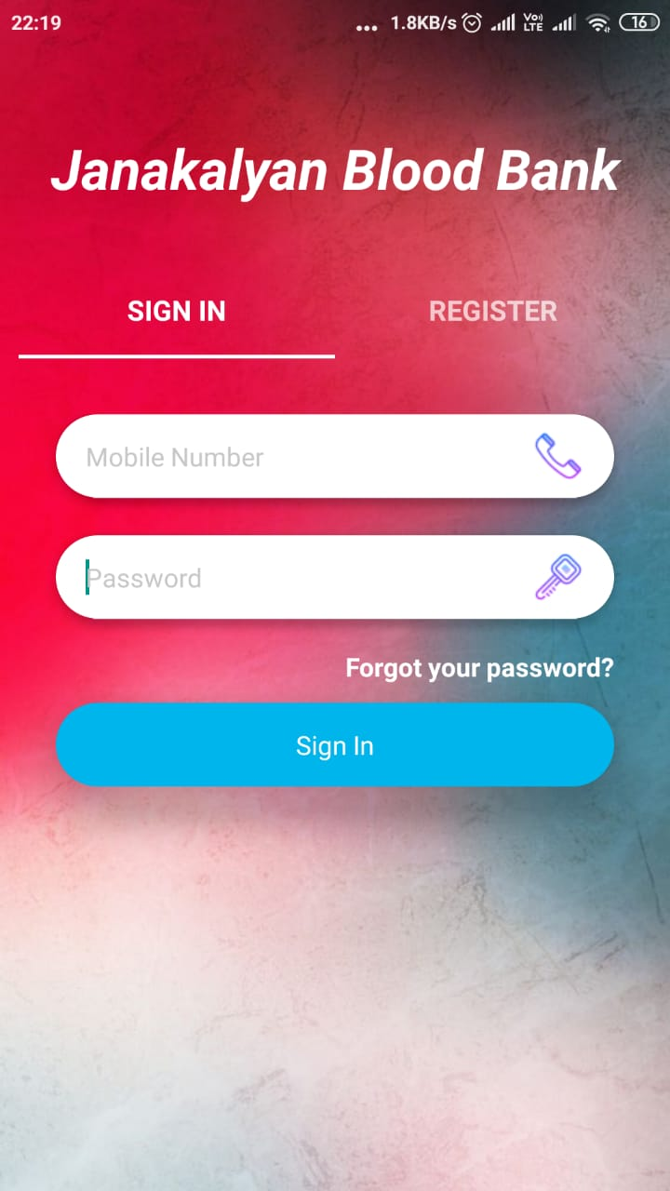
User login
- Any Registered Donor can Login from here

Slide 6
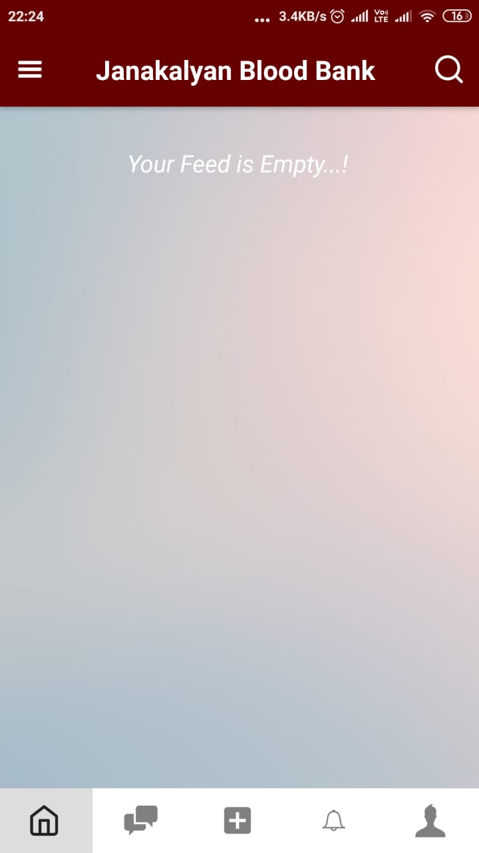
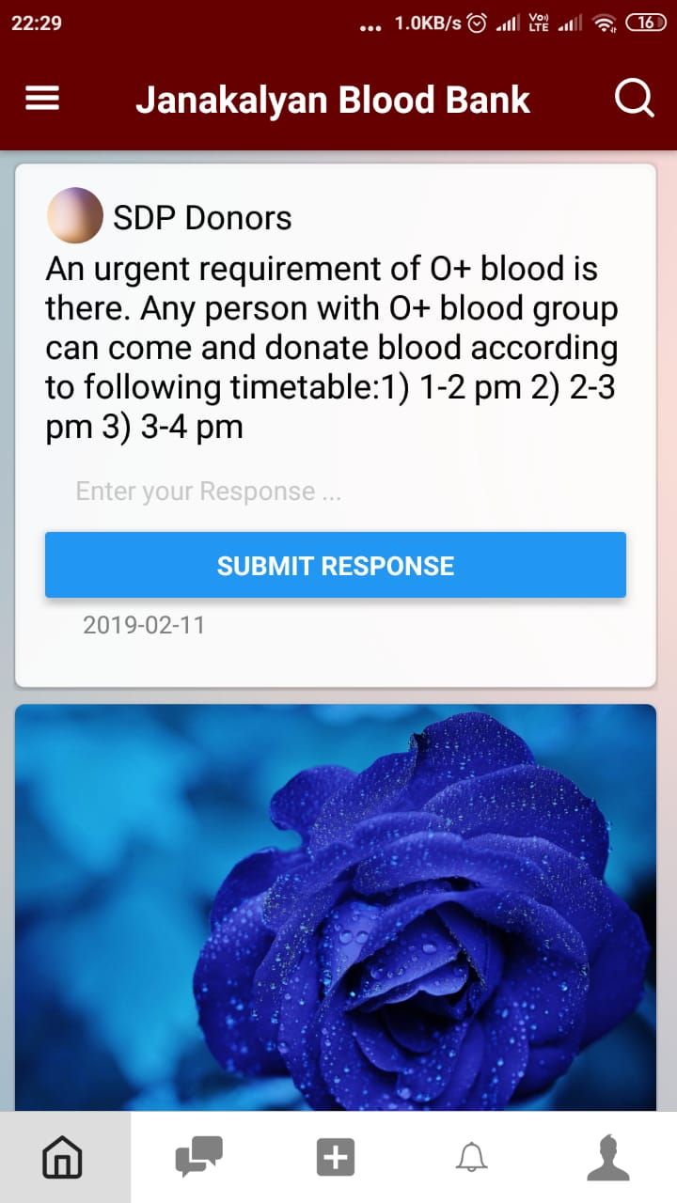
Your Feed
This includes posts
from a donors
groups and friends.
The posts include,
Text posts
Image posts
Form posts

Slide 7
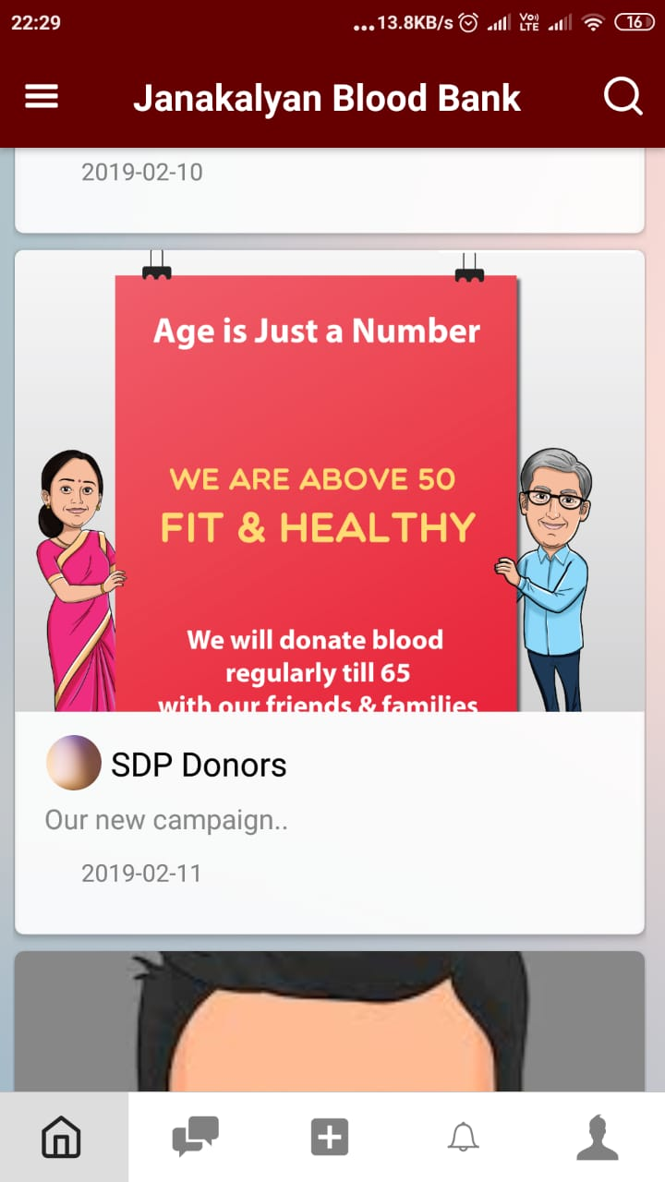
Types of posts
Form Post
Image Post

Slide 8
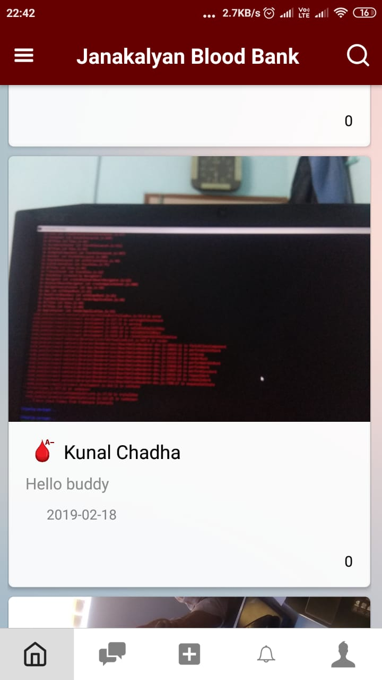
Group and Profile posts
Profile
Post
Group
Post

Slide 9
Form posts :
A form post is a post which records a
donors response and sends it to
the blood bank

Slide 10
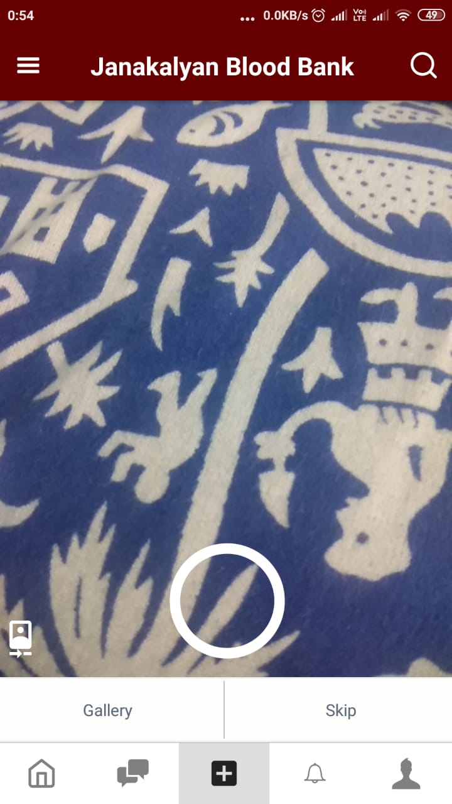
User can add post to his/her profile :
-User is provided with facility to add custom posts and share his/her blood donation activities with friends.

Slide 11
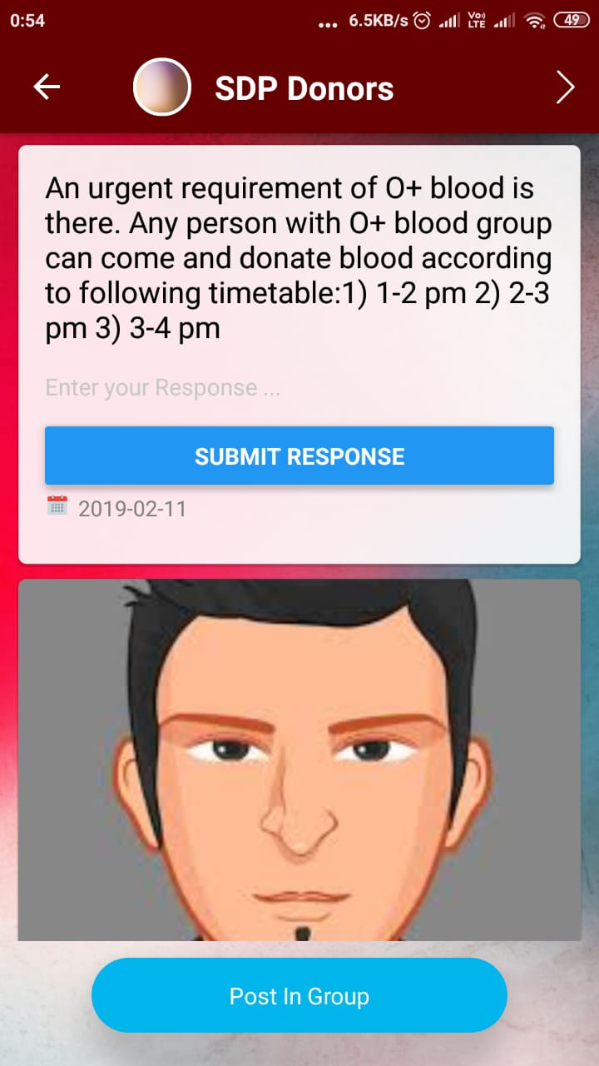
Group Page :
Group page is place where all posts relevant to that particular groups appear.

Slide 12
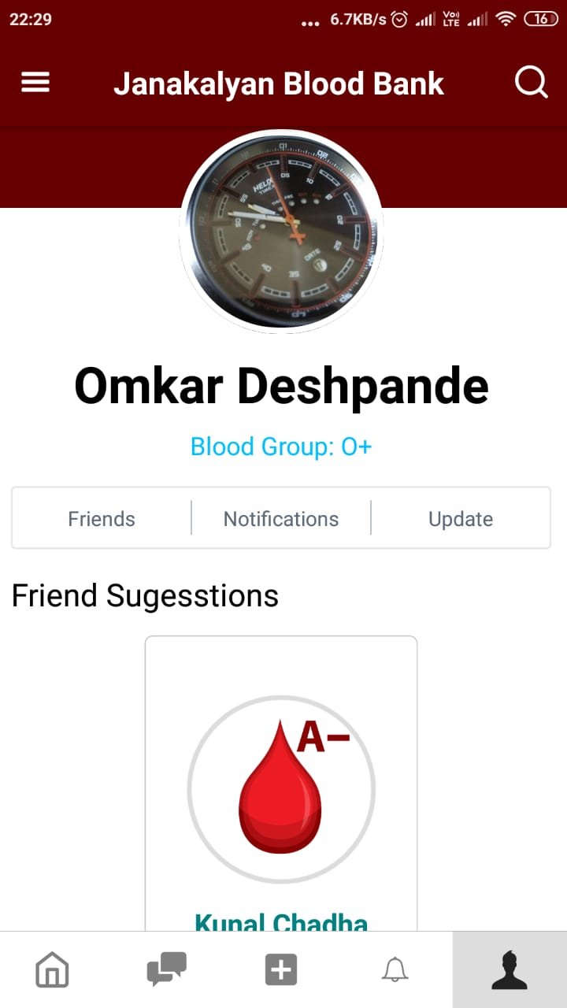
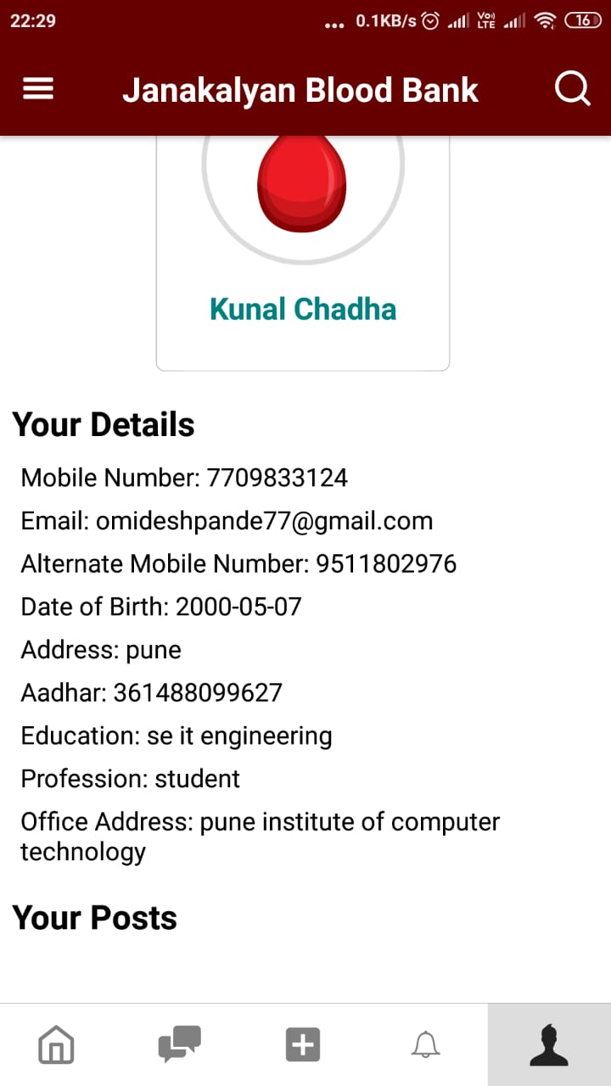
Profile
This is a
donors profile

Slide 13
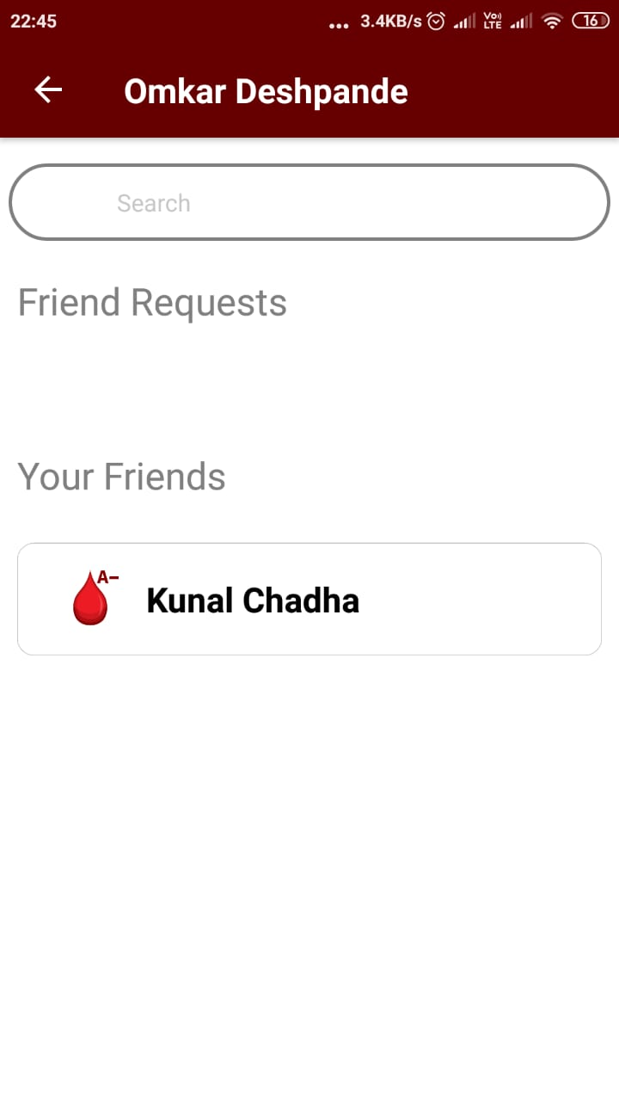
Friends
A donor can search
for his friends from here
Shows all the
friend requests that
the donor has received
Displays a list of
the donors friends

Slide 14
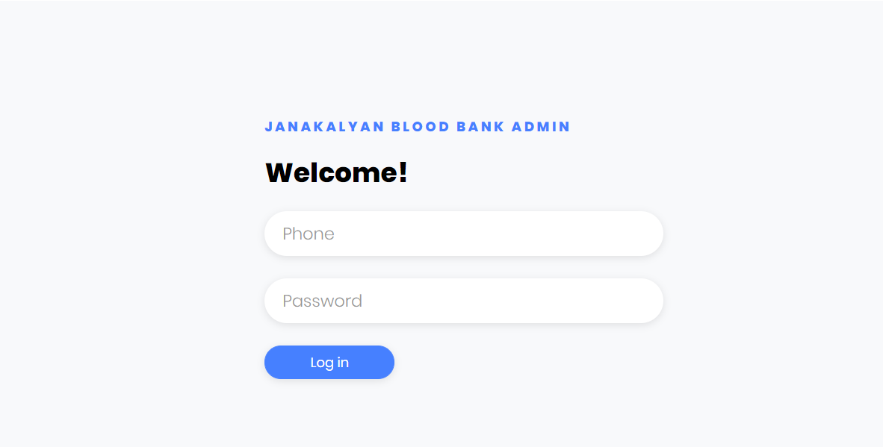
Admin panel

Slide 15
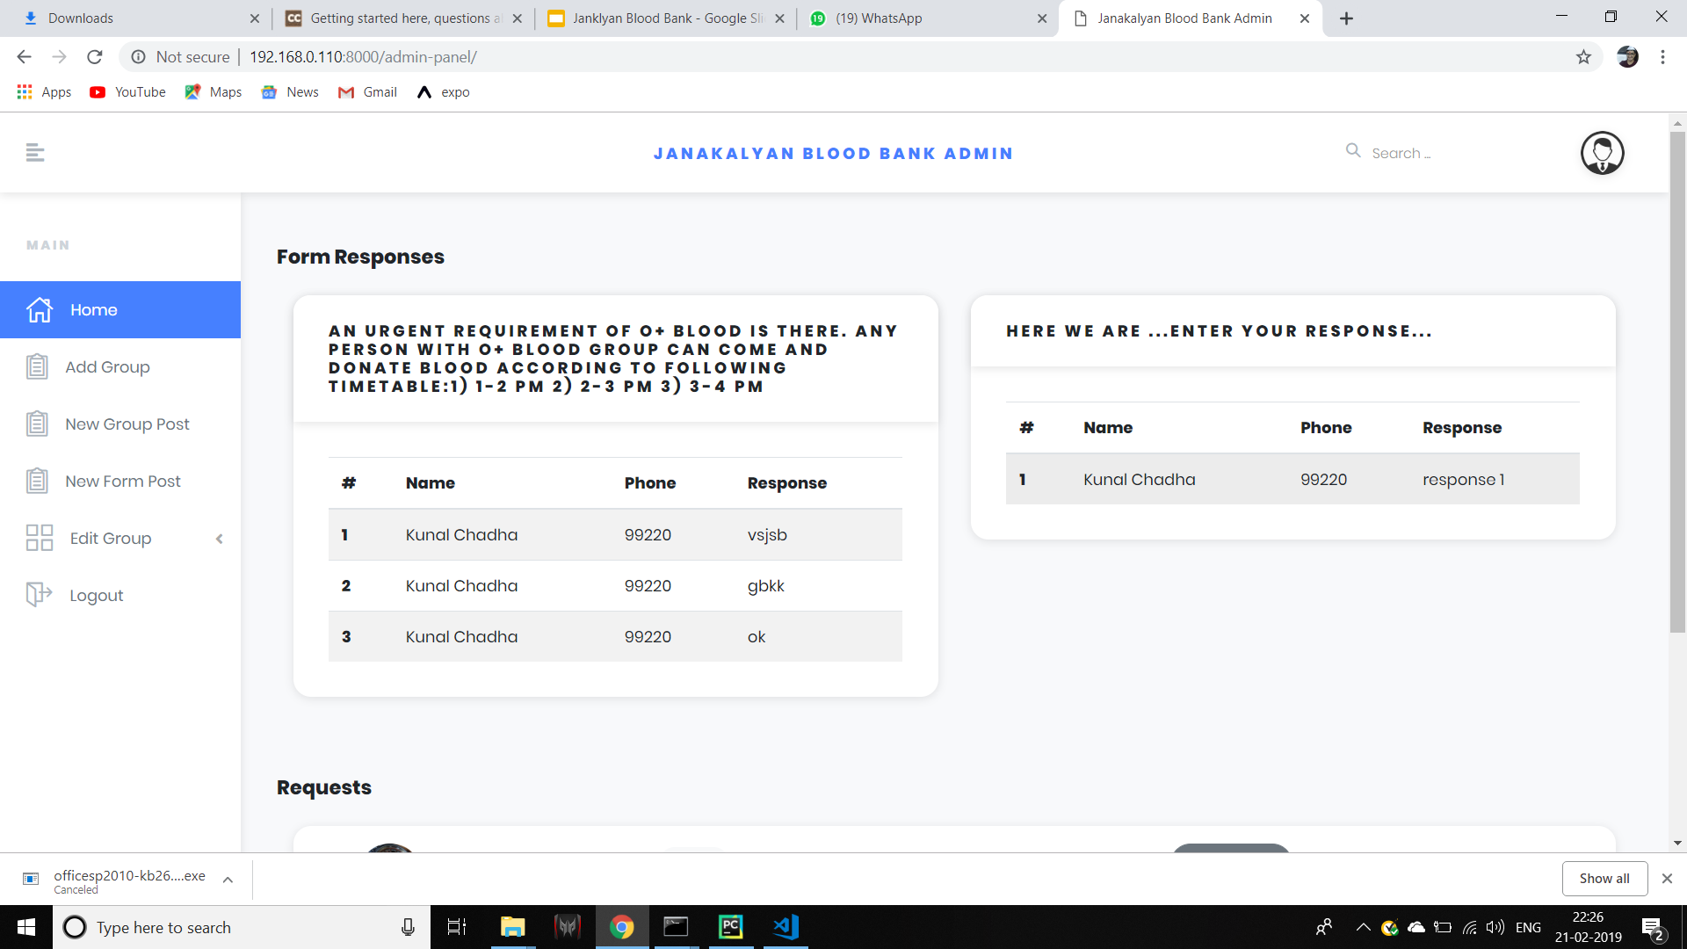
Admin Actvity

Slide 16
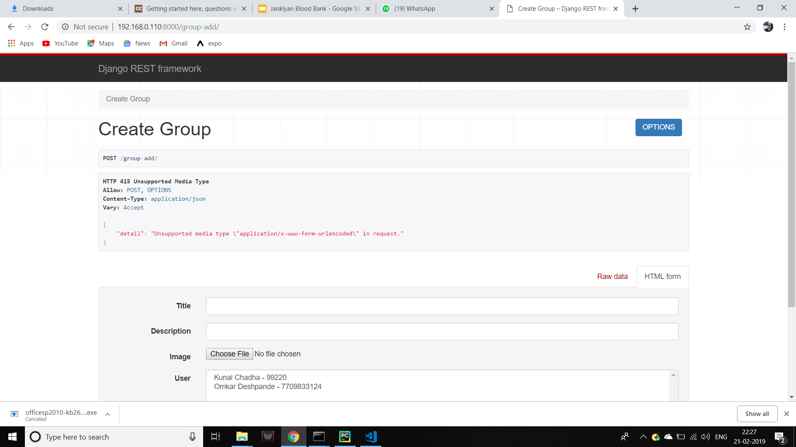

Slide 17
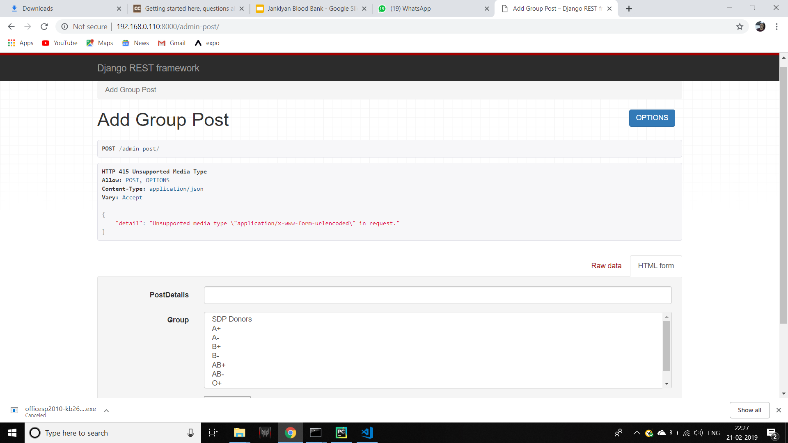

Slide 18
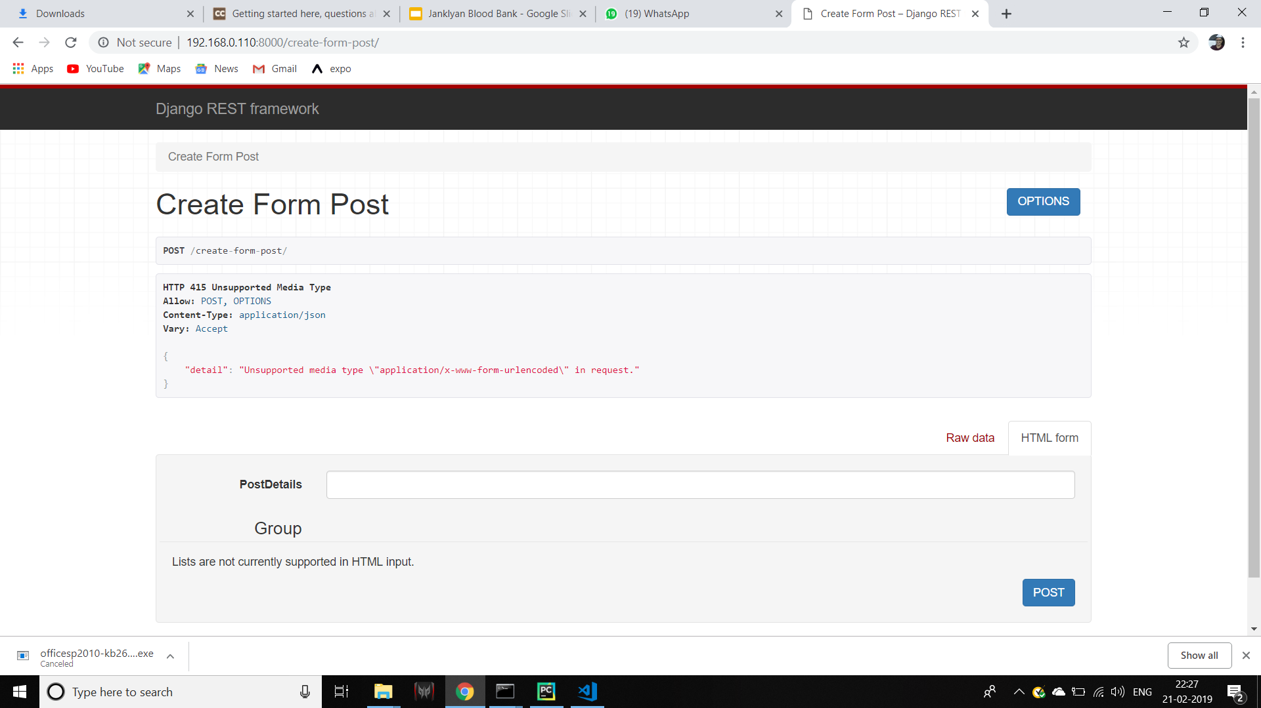

Slide 19
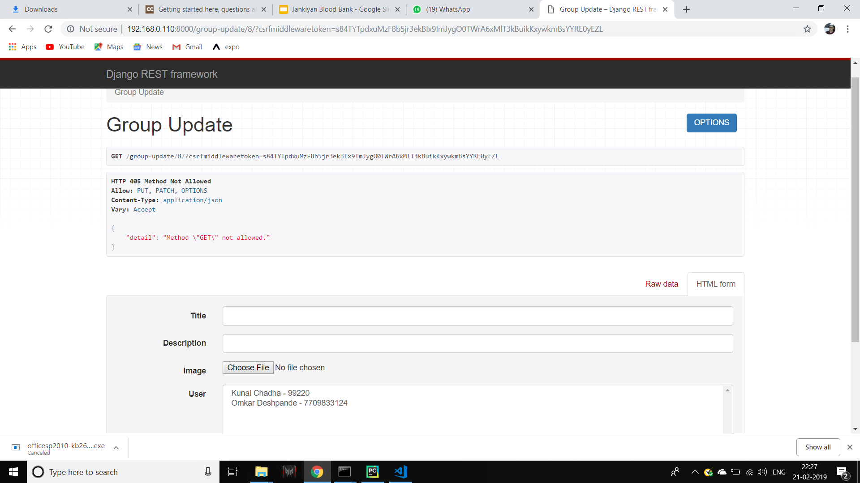

Slide 20
Costing
Includes :
Cost for hosting database on server.
Cost for launching application on android platform.
Cost for launching app on IOS platform (optional).
Cost for offline notifications using SMS services

Slide 21
Hosting database :
Amazon Web Services provides a service where the app can be hosted for 12 months for Free.
This service can be used to host this mobile app.

Slide 22
Launching application on android platform
One time payment of $25 for creating an account.
$25 = 1738.39 Indian Rupee (approximately)
Once an account is created and app is uploaded, there is no additional cost.

Slide 23
Launching app on IOS platform (optional)
$99 per year to keep your account active.
$99 = 6885.25 Indian Rupee ………(approximately)

Slide 24
SMS Services(optional)
Approximately 25 paisa per message

Slide 25
Thank You !!!

